Slide 1
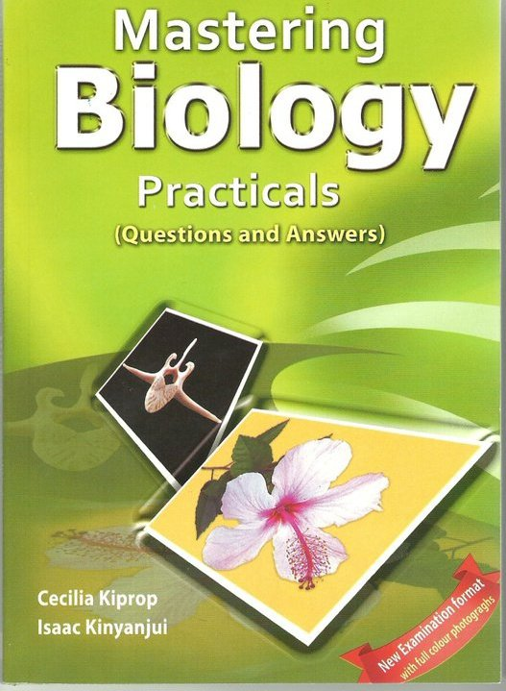

Slide 2
Science is different
“The basis of what scientists believe is the result of the careful collection and analysis of laboratory evidence.”

Slide 3
Value of BIOLOGY PAPER 3
EACH MARK is equivalent to 1% ,
The Paper contributes to 40% of the exam grade,
Plan to score over 35 marks out of the 40 marks possible,

Slide 4
Practical skills tested
Manipulative skills tested in;
Handling of chemicals & apparatus, e.g. enzymes, osmosis using visking tubing,
Cutting & preparing of sections , e.g. leaf sections, stem sections, flower sections,
Use of a hand lens,
Use of a light microscope,

Slide 5
Continued
Following instructions; in accordance with specified procedure. E.g. food tests, osmosis in plant tissue,
Observation, reading & interpretation; involves recognize, identify & interpret specimen
e.g. identify a specimen and give reasons for the answer.

Slide 6
Continued
Presentation of results & calculations from data; involves accurate and relevant conclusion.
E.g. change size & mass of plant tissue in varied solutions, Stomatal distribution

Slide 7
General experimental procedure
Read through ALL the questions carefully (in the first 15 minutes) without writing anything;
Determine the “Aim of the experiment”
Start with the question requiring to be left for a duration;
Avoid writing what is not required by the question;
Save time; While waiting for reaction to occur use the time to write the procedure;
Accurately record all observations, measurements, timing

Slide 8

(Paper 3) is organised into three questions
Each PRACTICAL EXAM paper has three questions,
one taken from botany,
the other from Zoology
the third from physiology.

Slide 9
Physiology Questions are designed to test a candidates’ ability to;
Follow instructions,
Handle apparatus safely;
Make accurate measurements;
Make accurate observations;
Record observations,
Evaluate & interpret observations using biological facts,
Use the recorded data in calculations,
evaluate experiments

Slide 10
Types of physiology questions
Food tests;
Enzymes investigation;
Osmosis investigations;

Slide 11
Food test questions
Start by seeking the identification of;
Starch;
Reducing sugar;
Non-reducing sugars;
Proteins;
lipids;
Vitamin C

Slide 12
Food tests
Food test are intended to identify the constituents of biological materials in;
Seeds;
Solutions;
Powders;
Fruits;
Seedlings;

Slide 13
Common mistakes in food tests as observed by examiners;
Wrong entries in the test column;
Wrong Order of answers;
Wrong procedure;
Wrong observation;
Negative deductions;

Slide 14
Appropriate test titles

Slide 15
Explaining Wrong Order of answers
Answers to section (a) should never be given in section (b) or vice versa;
Answers written outside the spaces provided will not be marked;

Slide 16
Explaining wrong procedure
No marks are awarded for observations and deductions if the procedure is wrong;

Slide 17
Mistakes made in the procedure
Including heating in tests do not require heating e.g. starch test, protein test,
Excluding heating in tests requiring heating; e.g. Benedict’s test;

Slide 18
Continued
Omission; e.g.
Failure to indicate amount of heating; instead of ”heating to boil”
Failure to state the form of reagents used like referring to Iodine alone instead of iodine solution;
Failure to state the quantity of the solution used instead of “added three drops of iodine solution”

Slide 19
Continued
Wrong order of presentation;
e.g. in protein test sodium hydroxide solution is added before the copper (II) sulphate solution;
In the test for vitamin C it is the solution of the food sample that is added to the reagent drop wise until no further change is observed. This is the only case where a food sample is added to the reagent.

Slide 20
Continued
Failure to mention the substance involved in the test;
Incorrect procedure; “add two drops of iodine solution and observe”
Correct procedure; “add two drops of iodine solution to substance M”

Slide 21
Continued
Use of “materials” not provided by the examiner. E.g.
If a powder is labeled “V” then it is wrong for a student to write; “to starch powder add two drops of iodine solution”
Because that information is not provided in the question;
Use of a white tile while non was provided in the starch test.

Slide 22
Wrong Observation
Wrong observation will lead to wrong conclusion;
Examples of wrong observations;
Greenish instead of light green,
Yellowish instead of light yellow,
Bluish instead of light blue,
No change instead of colour X persisted;
No reaction instead of colour X persisted;
Black instead of blue-black;

Slide 23
Negative Deductions are wrong
Use positive deductions as much as possible; e.g.
“Starch is not present” instead of “starch is absent”

Slide 24
REDUCING SUGARS TEST / BENEDICT’S TEST
Place 2 cm³ of a solution of the food substance being tested in test tube
Add equal amounts (2 cm³ ) of Benedict’s solution.
Heat to boil the resulting blue mixture
The colour changes from blue to green, then yellow, then orange, then red-brown precipitate.

Slide 25
Colours of results
Blue
Green
Yellow
Orange
Red/brown

Slide 26
HOW DOES THE HUMAN BODY BENEFIT FROM THE FOOD SUBSTANCES?
Starch
Benefits: on oxidation release energy in the body
Explanation; Starch is hydrolysed into glucose which in the cells is oxidized to release energy.

Slide 27
Continued
Reducing sugar
Benefit: on oxidation release energy to the body
Explanation; Glucose is oxidized in the cells to release energy
Non reducing sugars e.g. sucrose
Benefit: on oxidation release energy to the body
Explanation; The sugar is first hydrolysed into glucose /fructose which is then oxidized in the cells to release energy.

Slide 28
continued
Proteins
Benefit:
Growth e.g. thyroxine hormone,
Role in nutrition e.g. digestive enzymes,
Respiration & transport, e.g. haemoglobin,
Excretion e.g. urease in urea formation,
Support & movement, e.g. collagen, actin/myosin,
Sensitivity & coordination, e.g. rhodopsin,
Reproduction e.g. prolactin,

Slide 29
continued
Explanation
Proteins are digested into amino acids which are then used in synthesis of various proteins in the body. In extreme starvation condition the amino acids are oxidized to release energy for the body i.e. in the absence of carbohydrates and fats.

Slide 30
continued
Lipids
Benefit:
on oxidation provides energy to the body
Insulation of the body from cold i.e. heat insulators
Explanation
Fats are oxidized to release energy for the body (only in the absence of carbohydrates)
Stored fats / adipose tissue provides insulation to the body.

Slide 31
continued
Vitamins
Benefit: Protection of the body against deficiency diseases such as scurvy.
Explanation; Vitamins are co-enzymes which increase the rate of metabolism in the human body.

Slide 32
Physiological questions also involve enzymes

Slide 33
Physiological questions involving enzymes
Designed to test the student knowledge of enzymes,
Sources of enzymes may;
Biological tissues like liver, germinating seeds, Irish potato tuber, intestinal content, onion bulbs, carrot tips, apple,
Bought industrially made enzyme,

Slide 34
Enzyme based Questions involve;
Amylase ; hydrolyze Starch (amylose) into maltose;
Sucrase (invertase);hydrolyze sucrose (cane sugar) into glucose & fructose;
Catalase; converts hydrogen peroxide into water & oxygen;
Hydrogenase; remove hydrogen to oxidize animal & plant tissue;

Slide 35
Areas tested in enzyme questions
Effect of pH on rate of reaction;
Effect of temperature on rate of reaction;
Effect of enzyme concentration on rate of reaction;
Effect of substrate concentration on rate of reaction;
Effect of co-factors on rate of reaction

Slide 36
Enzyme; Sucrase
Hydrolyzes sucrose to fructose & glucose,
Found in; insect guts; plant storage organs like sugar cane stem, carrot tap root,
Tested by testing the production of reducing sugars using Benedict’s reagent,

Slide 37
Enzyme; catalase
Hydrolyzes hydrogen peroxide to water & oxygen;
Effervescences; indicates oxygen production hence shows catalase activity;
Arise in temperature also indicates catalase activity because the reaction is exothermic,

Slide 38
continued
Hydrogen peroxide is a toxic by-product of metabolic reaction; therefore cells with high metabolic reactions will accumulate this toxin hence the high concentration of catalase in such tissues like;
Liver,
Irish potatoes;
Apple
Germinating seeds;

Slide 39
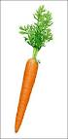
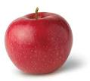
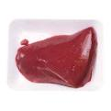
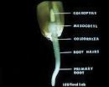
Photos of the tissues

Slide 40
Enzyme; amylase
Hydrolyzes starch to maltose;
Disappearance of starch detected using iodine solution indicates amylase activity;
Appearance of reducing sugar detected using Benedict’s reagent indicates amylase activity too,

Slide 41
Effects of temperature on enzymes
All enzymes have minimum, optimum & maximum temperature, depending on source;
The effect of temperature to any enzyme controlled reaction is to double the rate of reaction for every 10⁰c increase, until optimum (most favourable).

Slide 42
Continued
Temperature increase leads to high kinetic energy of enzymes & substrate,
Above optimum temperature vibrations of the enzyme break hydrogen & disulphide bonds within leading to a change in the active site this is denaturation,
Use a water bath to maintain a constant temperature,

Slide 43
Advantages of using a water bath in enzyme controlled reactions
Easier control of temperature,
Allow the candidate to pay attention parts of the question,
Safer because test tube do not spurt out,
Several solutions may be put in the same water bath,

Slide 44
Precautions in temperature effect on enzyme questions
Avoid heating hydrogen peroxide its unstable,
Keep all other factors constant,
Bring the enzyme & substrate solution to optimum before mixing,
If the question does not specify the temperature to investigate then choose below optimum & above optimum,

Slide 45
Effect of pH on enzyme activity
Every enzyme depending its source work at narrow optimum pH range,
The enzyme activity reduces outside this optimum, because the enzyme gets denatured,

Slide 46
Common acid-base indicators
Indicator | Colour in acid medium | Colour in base medium
Litmus | Red | Blue
Phenolphthalein | Colourless | Pink
Methyl orange | Pink | Yellow
Bromothymol blue | Yellow | Blue

Slide 47
Effects of co-factor on enzyme activity;
Presence of a co-factor like sodium chloride increases the rate of reaction,

Slide 48
How to detect a practical question involving enzymes
A practical question involving an enzyme has certain characteristics which should help one to discover even the type and name of the enzyme being used in the question.

Slide 49
suggested hints
Questions dealing with effect of temperature on enzymes;
will involve boiling some of the materials before it is allowed to react
Boiling is meant to denature the enzyme. This means that if the enzyme has been denatured it will not act on the substrate to give the products.

Slide 50
suggested hints
the element of time in the experiment suggests enzyme reaction,
The purpose of allowing the experiment to stay for 20 or 30 minutes is to give the enzyme time to work on the substrate.

Slide 51
suggested hints
working with two colourless solutions in food tests, then likely one of them may be hydrolysing enzyme and the other the substrate,

Slide 52
suggested hints
Mixing dilute HCL, or Na₂CO₃ with the a substance before allowing it to react with the second substance overtime,
Suggests the testing of the effect of pH on an enzyme,

Slide 53
suggested hints
the production of a gas during the experiment
E.g. In the fermentation of glucose by Zymase enzymes, glucose is broken by the enzymes to form ethanol energy and carbon (IV) oxide gas which forms bubbles and when tested with calcium hydroxide solution it turns white ppt.
Zymase enzymes are produced by yeast fungus.

Slide 54
suggested hints
the production of a gas during the experiment
E.g. Decomposition of hydrogen peroxide by catalase enzyme
If hydrogen peroxide is added to fresh animal or plant material, the catalase enzyme found in the tissue catalyses the breakdown of hydrogen peroxide forming water and oxygen gas which is given off as gas bubbles.

Slide 55
suggested hints
The catalase controlled reaction can be speeded up by increasing the surface area of the plant or animal tissue being used
e.g.
By slicing the specimen into smaller pieces
By crushing the specimen
By powdering the specimen

Slide 56
Commercial applications of enzymes
Pharmaceutical industry; catalase is used in wound dressings.
Catalase converts hydrogen peroxide in the dressing to oxygen and water. Oxygen speeds up healing and inhibits dangerous , anaerobic bacteria.

Slide 57
continued
Milk industry; lactase hydrolyzes lactose in milk in the processing of milk free of lactose for lactose intolerant persons,
Textile industry; leather for clothing is softened using a protease from bacteria
Detergent industry ; stains are removed using lipase, amylase and protease

Slide 58
continued
Food processing;
protease softens gluten, making the rolling of biscuits easier,
Isomerase converts glucose to fructose; this is sweeter so less needs to be used in slimmers’ biscuits,
Lipase ;helps chocolate coverings to flow

Slide 59
Physiological questions involving osmosis

Slide 60
Physiological questions involving osmosis include,
Observe the texture of plant epidermal cells, in varying solutions,
Measure length & mass of plant tissues,
Observe a visking tubing texture,
Use the data obtained to calculate % change in size & mass,

Slide 61
Osmosis questions
Designed to test;
water relations of plant cells;
Effects of hypotonic & hypertonic solutions on cells & tissue;

Slide 62
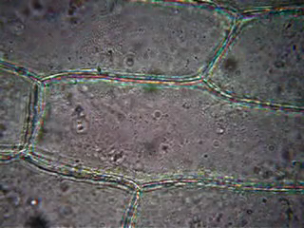
Plasmolysis of onion cells

Slide 63
Electron micrographs in
Zoology & botany
questions

Slide 64
Electron micrograph questions in botany or zoology
The evaluation will involve;
Identification of organelles,
State the functions of the organelles,
Determine the size of organelles,
Identify cell activity at the time of micrograph,

Slide 65
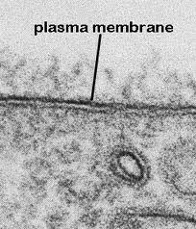
Hints on Identification of various structures in electron micrographs
Cell membrane will show as;
two parallel dark lines (tramline appearance)
Invaginations of phagocytosis & pinocytosis,

Slide 66
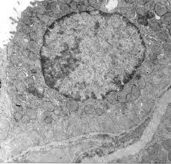
Identify the cell membrane

Slide 67
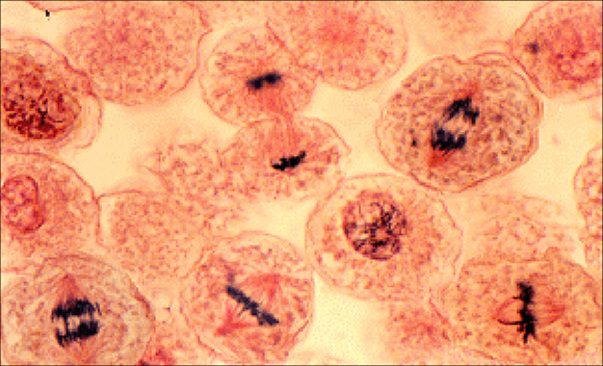
Identify the stages of cell division

Slide 68
Interpreting Nucleus micrograph
Nucleus appears large & bounded by a double-layered membrane,
Nucleolus appears circular part inside the non-dividing nucleus ,
Chromosomes or chromatids appears dark,
Nucleoplasm is lighter,

Slide 69
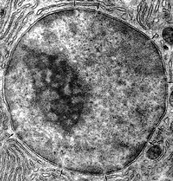
Identify the Nucleus parts

Slide 70
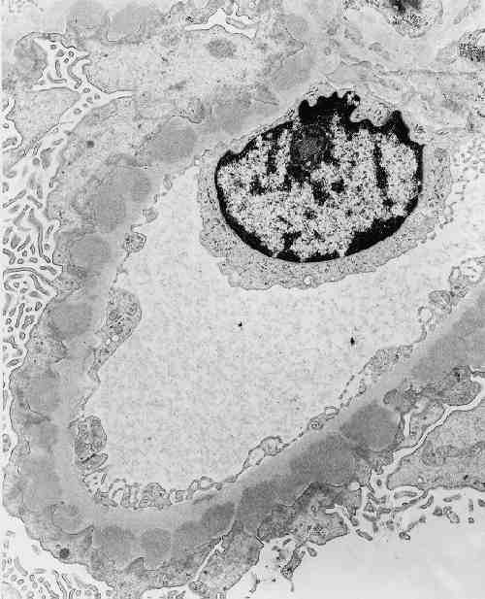
Interpreting cytoplasm micrograph
Cytoplasm appears clear with dark spots scattered all over the cytosol.

Slide 71
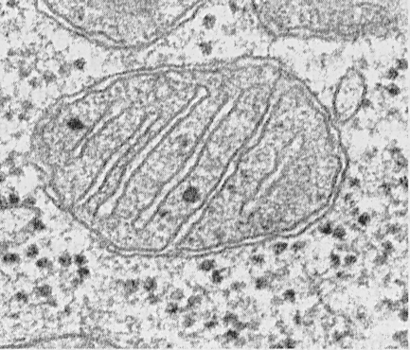
Interpreting mitochondrion micrograph
Appear as dark shape with outer membrane surrounding an inner highly folded membrane.

Slide 72
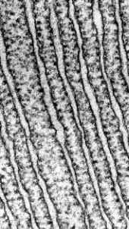
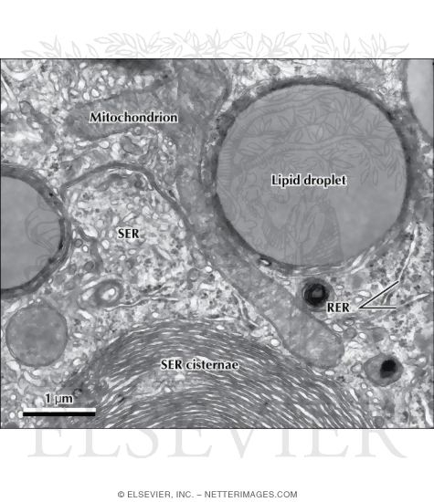
Interpreting endoplasmic reticulum (ER) micrograph
Rough ER; Appear as double membrane extending from nucleus membrane marked with granular spots (ribosomes)
Smooth ER; appear as
double membrane with a entire surface.

Slide 73
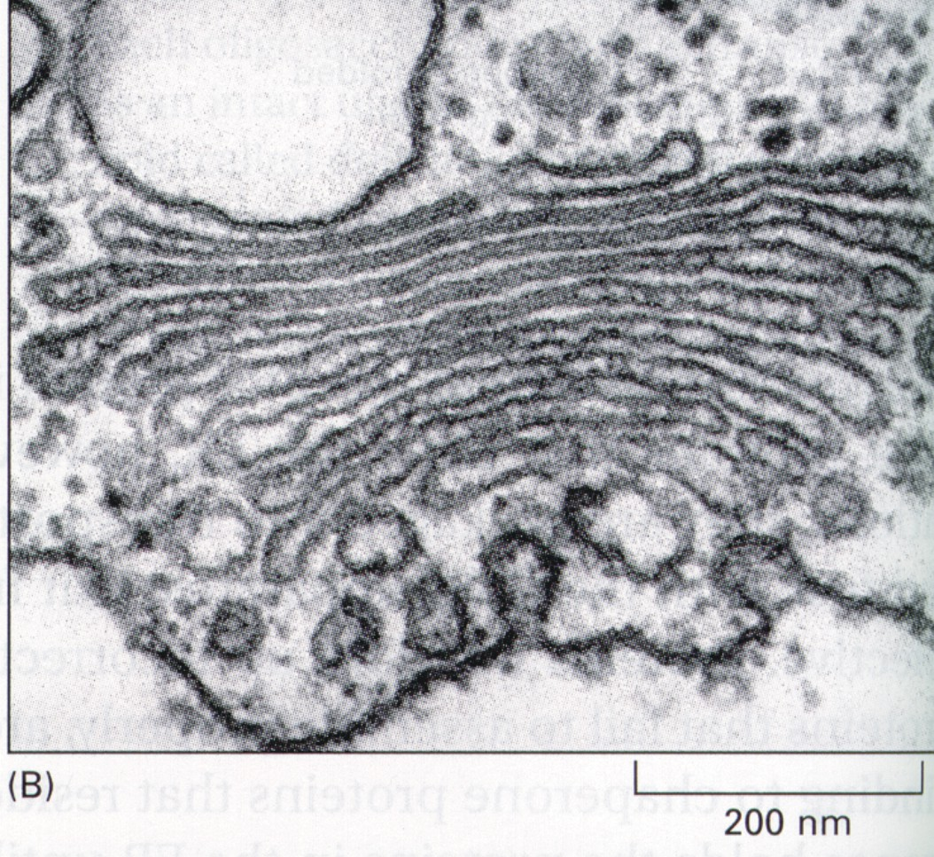
Interpreting Golgi apparatus micrograph
Appear as flattened sacks packed together

Slide 74
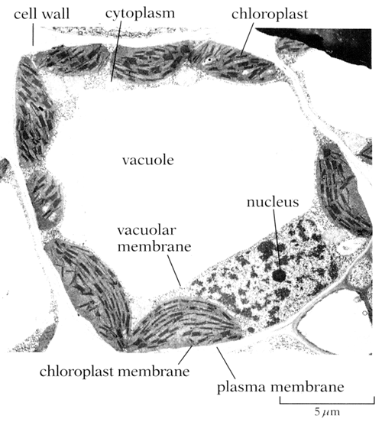
Interpreting cell vacuoles micrographs

Slide 75
How to identify the activities taking place in a cell at the time when the micrograph was prepared
Cells actively synthesizing proteins have prominent rough ER,
Cells actively secreting materials like enzymes, mucus have prominent Golgi body,
Abundance of mitochondria suggests high metabolic activity,
Meristematic tissue have cells with large nuclei,

Slide 76
Dichotomous key; an identification key in zoology & botany questions

Slide 77
Guidelines on how to use dichotomous keys
Dichotomous keys consist of a series of observable features numbered and contrasting pairs called “leads”.
To identify any organism read through the first pair statement and decide which fits the organism, if not follow the lead until you identify the organism.

Slide 78
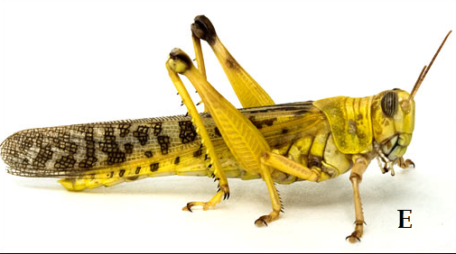
Example

Slide 79
Use the photos with the dichotomous keys to identify the organisms
1.(a) head with antennae………….go to 2
(b) head with no antennae….go to 3
2. (a) head with two pairs of antennae…go to 4
(b) head with one pair of antennae ….go to 5
3. (a) body divided into a cephalothorax and abdomen with a definite waist at their junction……………………………………spider
(b) body divided into a cephalothorax and abdomen without a definite waist at their junction……………………………………tick
4. (a) body covered by a hard chalky exoskeleton………crayfish
(b) Body covered by a delicate exoskeleton……………….water flea
5. (a) has three pairs of walking legs…………………………..grasshopper
(b) Has many pairs of walking legs………………………… go to 6
6. (a) has one pair of legs in each segment………………..centipede
(b) Has two pairs of legs in each segment…………………millipede

Slide 80
Complete this table
Specimen | Step followed | Identify
E | 1a,2b,5a | grasshopper
F
G
H
I
J
K

Slide 81
Basic guidelines on construction of a dichotomous key
Number of leads is equal to number of organisms minus one
List the observable and taxonomic features of each specimen,
The first feature used should divide the specimen into two proper taxonomic groups. E.g. venation type, cotyledon type, skeleton type,
Use the other features to isolate the specimen from the rest of the group. E.g. leaf type, leaf margin type, number of legs,

Slide 82
Example; construct a dichotomous key to identify the following insects

Slide 83
Make a table of identifying features
features | butterfly | bee | Dragon fly | housefly | Louse
Wings | Present | Present | Present | Present
Number of wings | Two pairs | Two pairs | Two pairs | One pair
Nature of the wings | Scaly wings | All membranous | All membranous | Membranous
Abdomen size | Medium size | Medium size | Long | Medium size
Nature of the Body | Flattened body | Not flattened | Not flattened | Not flattened

Slide 84
Constructed dichotomous key
1. (a) wings present……………………………………….go to 2
(b) Wings absent…………………………………………..go to 7
2. (a) two pairs of wings………………………………….go to 3
(b) One pair of wings………………………………………house fly
3. (a) both pairs of wings membranous ………………go to 4
(b) Only the hind pair of wings membranous………go to 6
4. (a) relatively long abdomen………………..……… dragon fly
(b) Medium size abdomen……………………………..…go to 5
5. (a) both pairs of wings covered by coloured scales………butterfly
(b) Wings not covered with scales……………………bee
6.(a) front wings hard and shell-like……………………..beetle
(b) Front wings leathery…………….…………………..grasshopper
7. (a) body dorsal ventrally flattened…………………….louse
(b) Body laterally flattened………………………..…..flea

Slide 85
Biology illustrations in zoology & botany

Slide 86
Drawing vs diagram
Diagram is a representation of an idea and not necessary an accurate record of reality.
Drawing is an accurate record of a real specimen.

Slide 87
What examiners look for in a drawing
Implements used; use a pencil only to draw and NOT ink.
Best implements are;
Sharp HB pencil
soft eraser
Ruler- to draw label lines
New sharpener

Slide 88
Continued
Title or heading; every drawing must has a title above or below the drawing.
E.g. parts of a leaf, cross-section of an orange fruit

Slide 89
continued
Size of drawing ; correct size uses about 75% of space provided,
Smaller drawings suggest uncertainty, laziness and no need to be awarded marks

Slide 90

continued
Magnification ; is the ratio of drawing to specimen. E.g. x2
$magnification=\frac{drawing length}{actual length}$
Remember; no units with magnification
X sign indicates magnification & appears before the figure

Slide 91
continued
Clarity of lines; lines must be thin, continuous & freehand drawn.
Avoid blurred lines, messy lines, line drawn over each other, and heavy lines.

Slide 92
Clarity of lines continued
The following should be drawn with double lines to show dimensions;
Roots of plants
Edges of longitudinally cut flowers
Edges of cut fruits
Filaments of stamens

Slide 93
Continued
Proportions; reasonable representation of different lengths of the specimen.

Slide 94
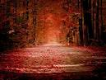
Continued
Neatness of labeling and labels;
Draw all label lines with a ruler,
Label lines must never cross each other,
Label lines must be whole,
Label line must touch the part being labeled,
Label line are without arrow heads,
Fully label all parts of a drawing,
Use a pencil to draw label lines,
Use ink to write labels,

Slide 95
Continued
Accurate drawing; drawing must show the true number of parts.
Its wrong to draw twenty parts of a structure while in reality they are ten.
Therefore;
Being keen to detail,
Draw what is seen,
Count up the structures,
Measure the parts and draw accurately

Slide 96
ANATOMICAL TERMINOLOGY

Slide 97
REVISION OF PAPER 1,2 & 3 USING DIAGRAMS

Slide 98
For each diagram you draw use the following format for effective study
Identify the diagram i.e. what is the name of the diagram / photograph / system?
Give reasons for the identification,
Study the labeled parts of the diagram.
State the functions of the labeled parts.
State the adaptations of the labeled parts to their functions
What are the differences between the labeled parts?

Slide 99
EXAMPLE 1
Write the identification of the drawing or diagram (1 mark)
Give the reason(s) for your answer in (a) above (3 marks)
Label all the parts appropriately (4 marks)
Give the function(s) of each part labelled in (c) above (4 marks)
State the adaptation(s)/modification (s) of each of the structures labelled in (d) above (4 marks)
State the distinguishing feature(s) of each structure labelled in (d) above (4 marks)

Slide 100
EXAMPLE 2
Write the identification of the drawing or diagram (1 mark)
Give the reason(s) for your answer in (a) above (3 marks)
Label all the parts appropriately (4 marks)
Give the function(s) of each part labelled in (c) above (4 marks)
State the adaptation(s)/modification (s) of each of the structures labelled in (d) above (4 marks)
State the distinguishing feature(s) of each structure labelled in (d) above (4 marks)

Slide 101
THANK YOU
FOR
YOUR TIME

